Slide 1

MAVEN PIZZA CHALLENGE ANALYSIS
Microsoft Power BI

Slide 2
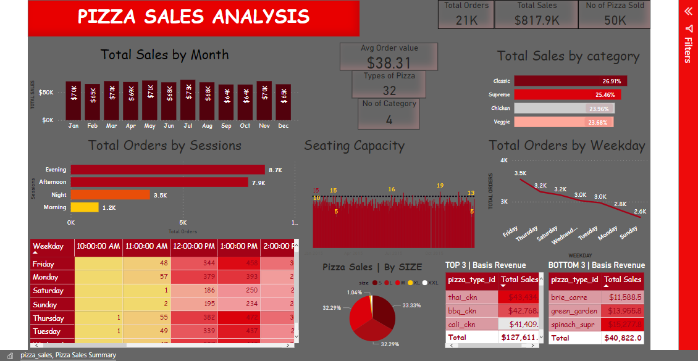
Microsoft Power BI

